Slide 1
Gravity
Our solar system and beyond

Slide 2
how to use Oak lessons
This lesson includes additional materials which can be downloaded from the lesson page.

Slide 3
I can describe the effects of gravity acting towards the centre of a nearby planet, moon or star.

Slide 4
gravitational force
attraction
orbit

Slide 5
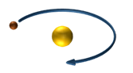
Gravitational forces pull objects towards large objects like planets, moons and stars.
An attraction is a force that acts to pull one object towards another.
An orbit is the path one object takes around another object.

Slide 6
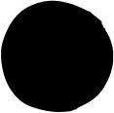
Gravity
Gravitational attraction
Gravity on the Moon and other planets
Gravity in our solar system

Slide 7
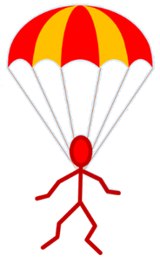
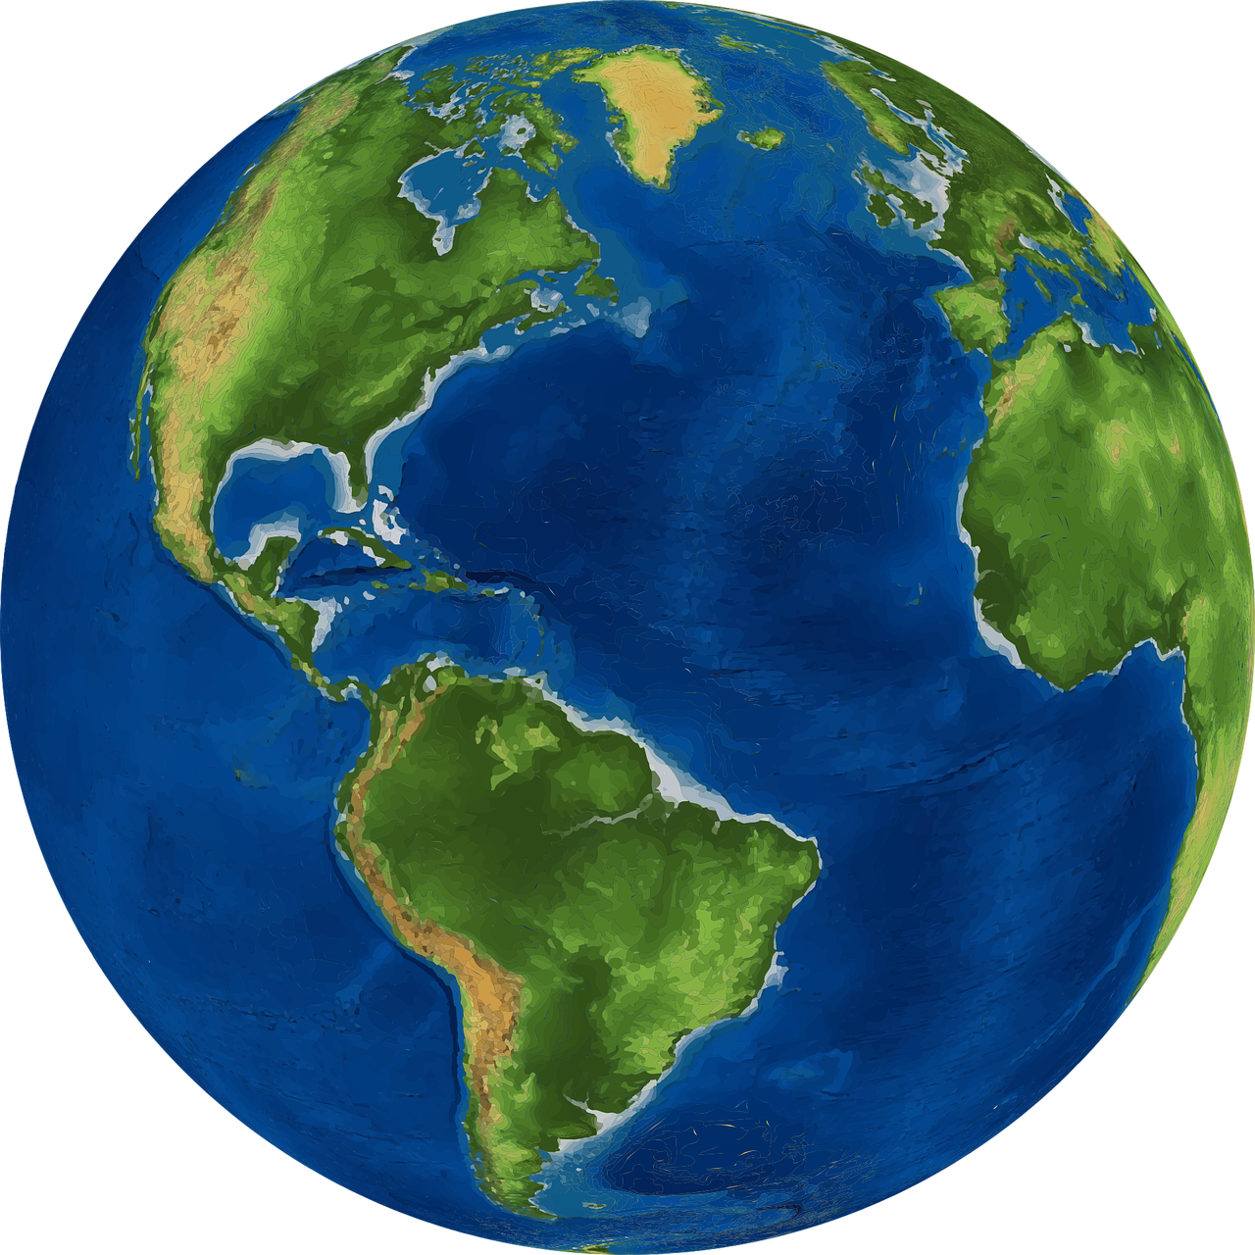
Gravitational attraction
Gravitational forces pull objects towards large objects like planets, moons and stars.
the gravitational force of Earth on the parachutist
Gravitational forces can also be called weight forces, or just ‘weight’.
Gravitational forces should never be labelled just as ‘gravity’.

Slide 8
Gravitational attraction
Gravitational forces are non-contact forces because the objects do not have to be touching for the force to act.
Magnetic forces are also non-contact forces.
N
S
N
S

Slide 9
Gravitational attraction
Magnetic forces can cause magnets to attract or repel.
N
S
N
S
N
N
Gravitational forces only ever cause attraction, towards the centre of the nearest planet, moon or star.

Slide 10
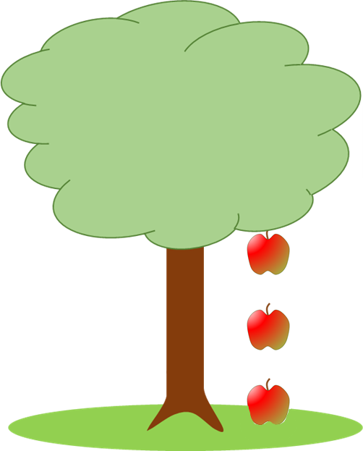


Gravitational attraction
The picture shows an apple falling from a tree.
At which point(s) is a gravitational force acting on the apple?
Choose as many as you think.
a
When the apple is still on the tree.
b
When the apple is falling.
c
When the apple is on the ground.

Slide 11
Gravitational attraction
Earth’s gravity causes the attraction that pulls things towards Earth.
Earth’s gravity extends far into space but gets weaker with increasing distance.
Earth’s gravity
A gravitational force acts on any object within Earth’s gravity.

Slide 12
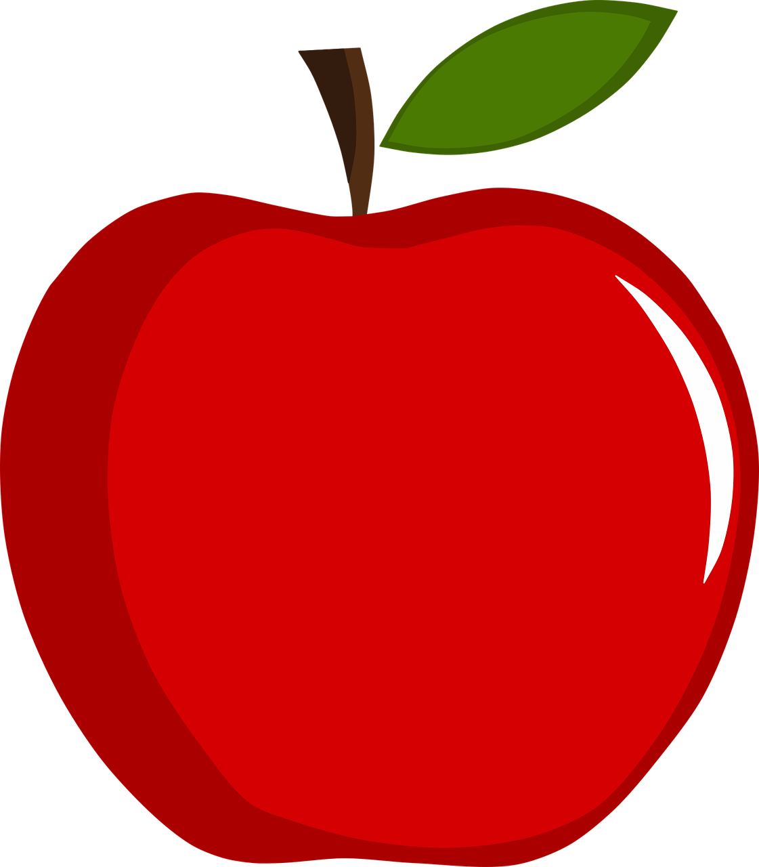
Gravitational attraction
Earth’s gravity always attracts/pulls objects towards the centre of Earth.
The direction of ‘down’ really means the direction of gravitational attraction (the direction things fall through air).
This is a different direction on different parts of Earth’s surface.

Slide 13
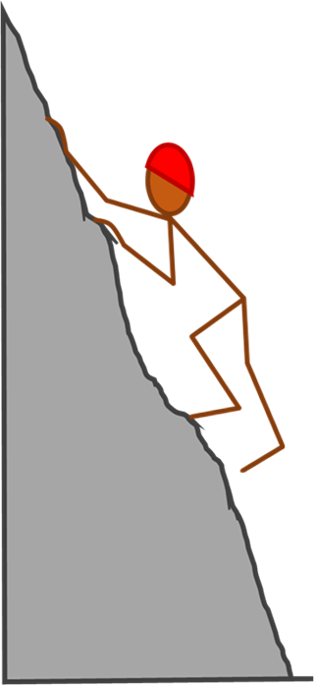
Gravitational attraction
Which way does gravity pull on this climber?
a
Justify your answer.
a
Gravity pulls objects upright.
b
Gravity pulls towards Earth’s surface.
b
c
Gravity pulls towards Earth’s centre.
c
d
d
Gravity pulls towards the ground.

Slide 14
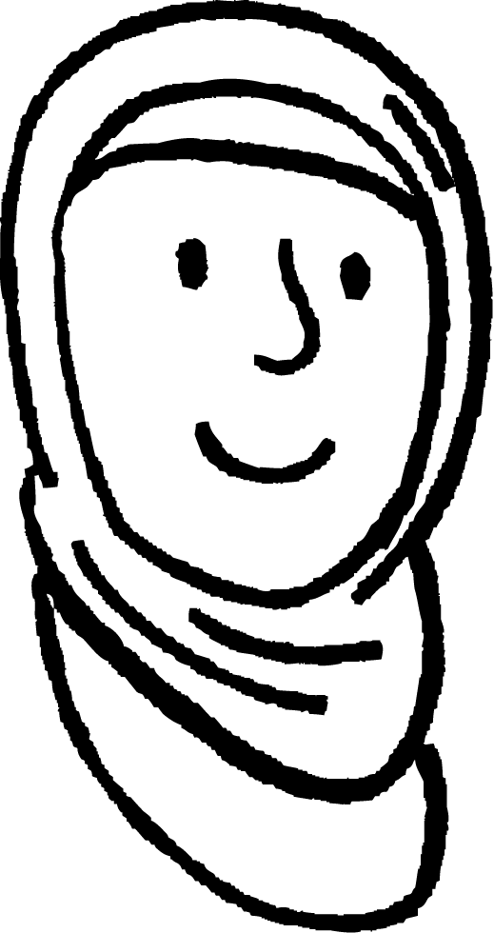
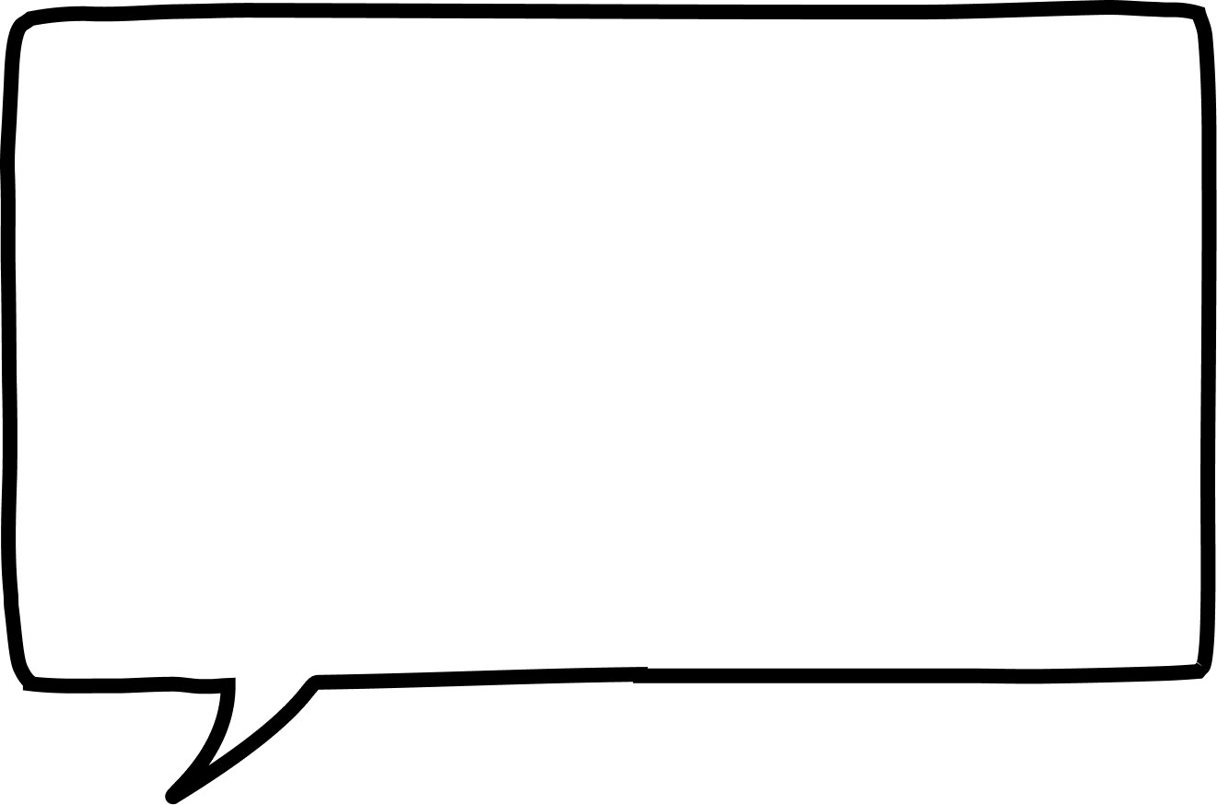
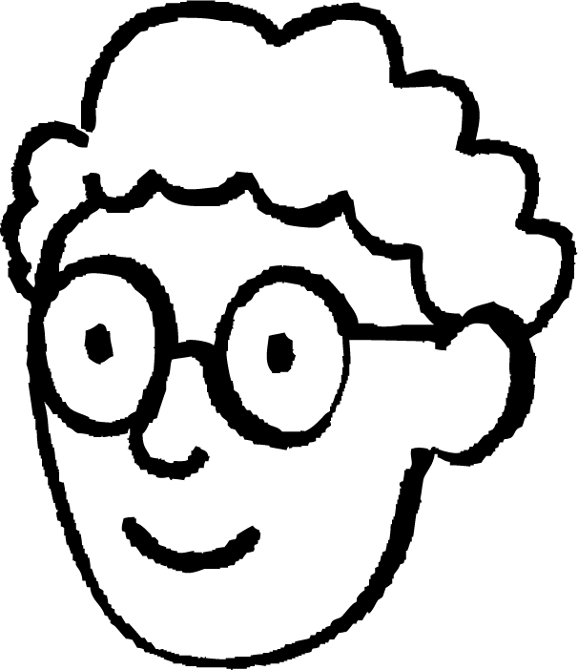
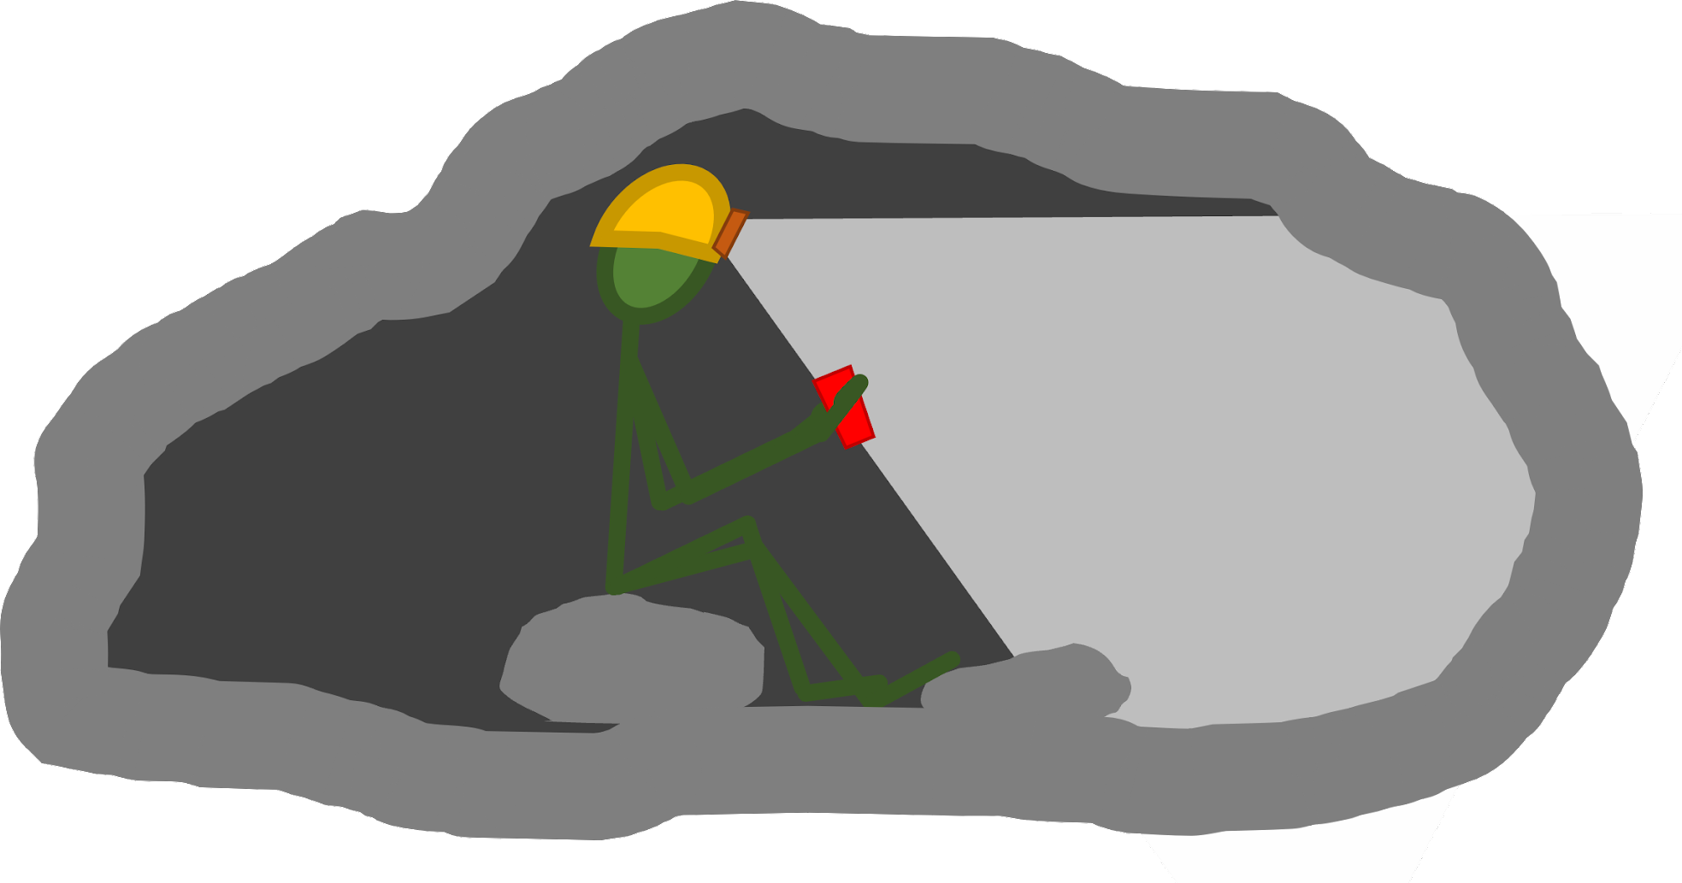
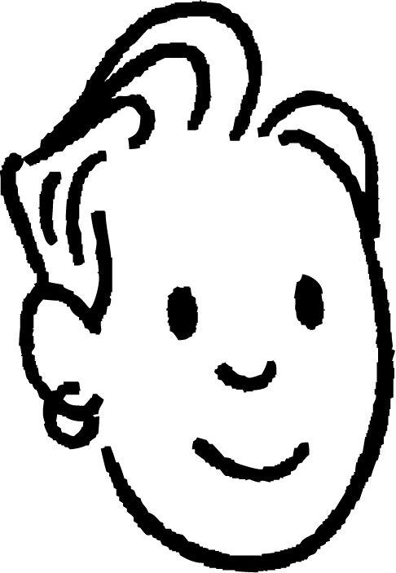
Gravitational attraction
A person is exploring a cave. They are 100 metres under Earth’s surface and surrounded by rock in all directions.
Gravity pulls towards Earth’s surface, which is upwards here.
Aisha
Gravity will pull them towards every surface, so they will float.
Alex
Gravity pulls them downwards in the picture.
Sam
1) Which pupil is correct? Explain why they are correct.
2) Explain why the other two pupils are incorrect.

Slide 15
Gravitational attraction
Gravity pulls them downwards in the picture.
Sam
1) Which pupil is correct? Explain why they are correct.
Sam is correct because gravity pulls objects towards the centre of the Earth, which is downwards in the picture.
2) Explain why the other two pupils are incorrect.
The other pupils are incorrect because people are not pulled upwards and do not float around when they go underground, e.g. in a basement, subway or railway tunnel. Both pupils have made the mistake of thinking gravity attracts objects to surfaces, which is not correct. Gravity attracts objects towards the centre of Earth.

Slide 16
Gravity
Gravitational attraction
Gravity on the Moon and other planets
Gravity in our solar system

Slide 17
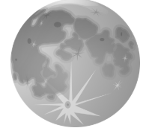
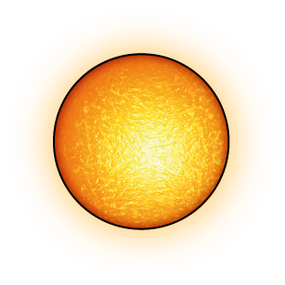
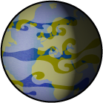
Gravity on the Moon and other planets
There are many differences between Earth and the Moon.
Earth is a planet orbiting the Sun.
The Moon orbits Earth at the same time.
Earth is much larger than the Moon.
Earth has an atmosphere (air), but the Moon does not.

Slide 18
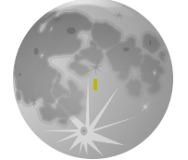
Gravity on the Moon and other planets
However, Earth and the Moon both have gravity.
The Moon’s gravity:
The strength of gravity on the Moon’s surface is smaller than on Earth’s surface, because the Moon has less mass.

Slide 19
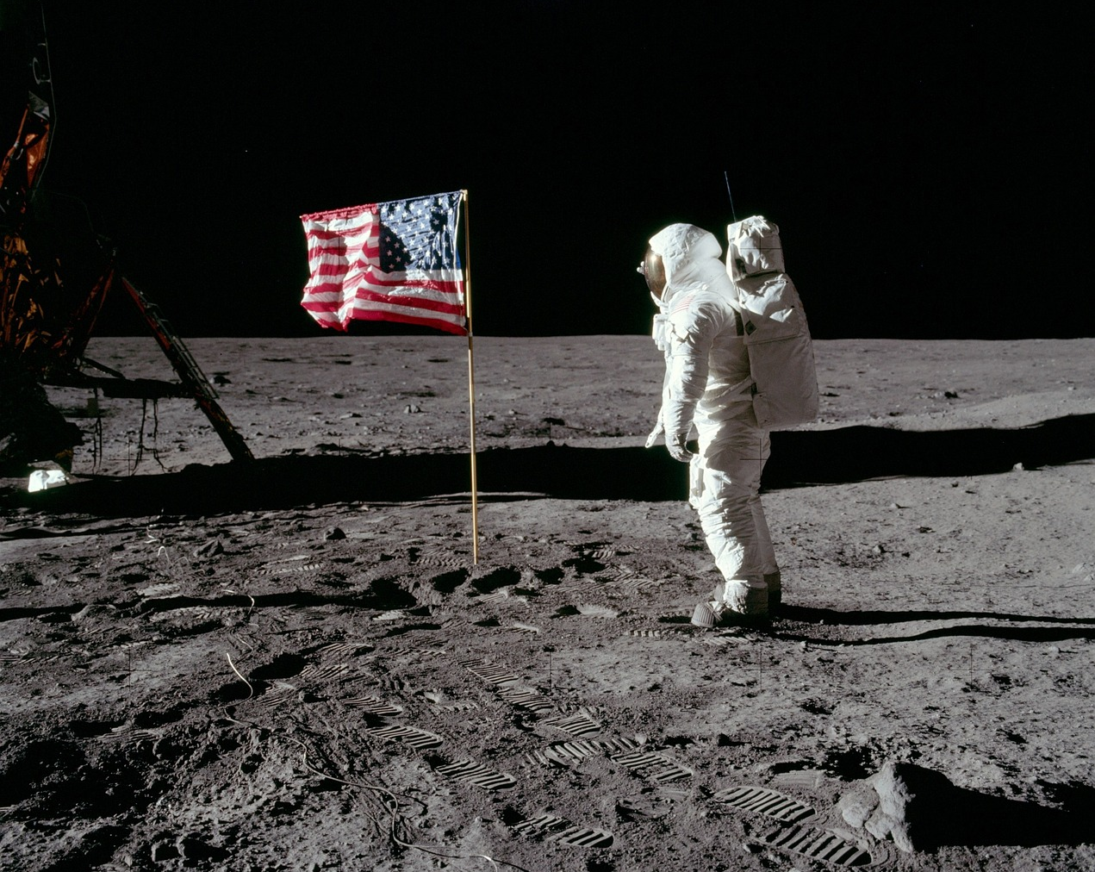
Gravity on the Moon and other planets
Photographs taken on the Moon show there is gravity there.
This photograph was taken on mission to the Moon.
Gravity is clearly holding everything down.

Slide 20
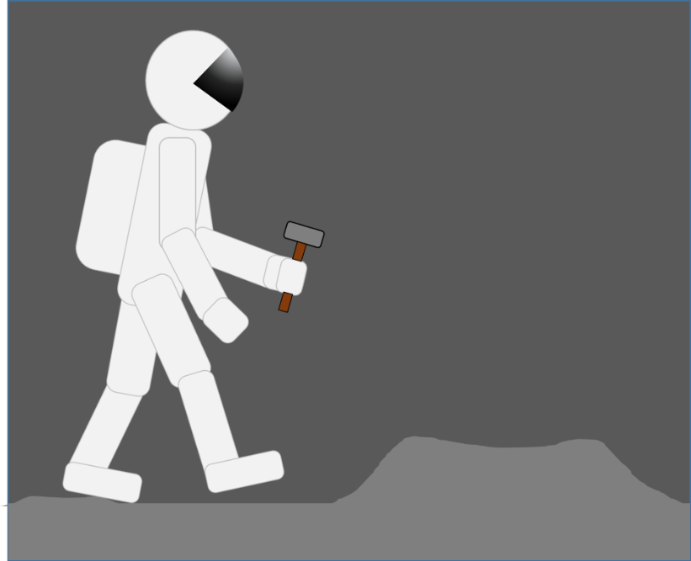
Gravity on the Moon and other planets
An astronaut is walking on the Moon, carrying a hammer. Which is true?
a
There is no gravity, only Earth has gravity.
b
There is no gravity because there is no air.
c
Gravity is stronger than on Earth.
Gravity is weaker than on Earth, she can jump higher and falls back down more slowly.
d
e
If the astronaut lets go of the hammer it will just float next to her.

Slide 21
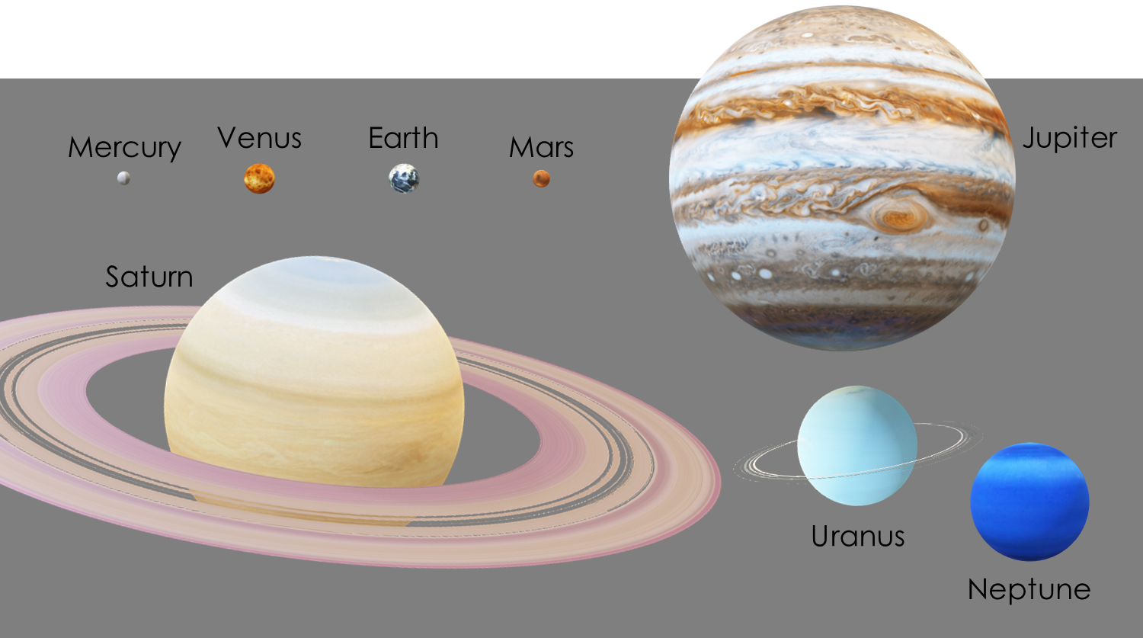
Gravity on the Moon and other planets
All very large objects have gravity: stars, planets, moons, dwarf planets etc.
The larger the mass of an object, the stronger its gravity.
Mars’ gravity
Neptune’s gravity
Gravity is always strongest at the surface and slowly weakens with increasing distance.

Slide 22
Gravity on the Moon and other planets
Neptune’s gravity
Mars’ gravity
220N
75 N
A greater gravitational force would act on the same bag on a planet with a greater mass, due to the stronger gravity there.
(Note - the ‘surface’ of Neptune is gaseous so you couldn’t actually stand on it.)

Slide 23
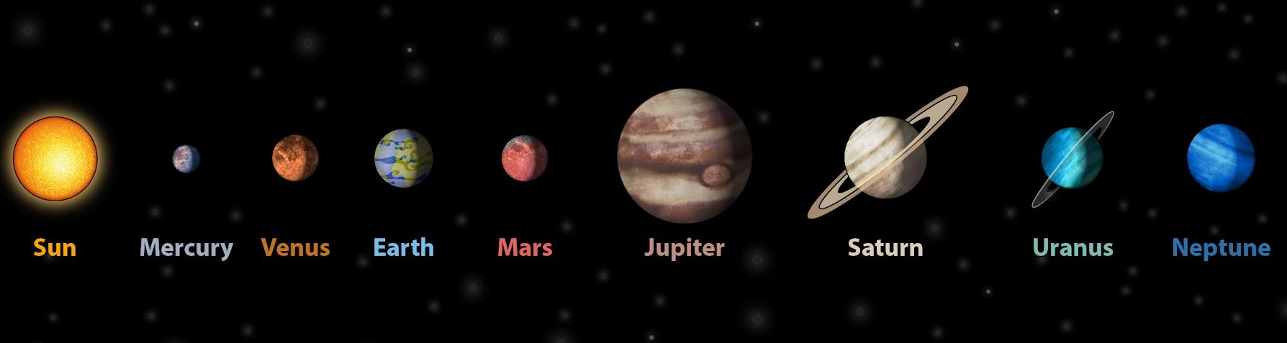
Gravity on the Moon and other planets
The sizes of the planets in the diagram represent the real sizes.
Which planet do you think will have the strongest gravity close to its surface? Why?
Jupiter, because it is the largest, it has the most mass.

Slide 24
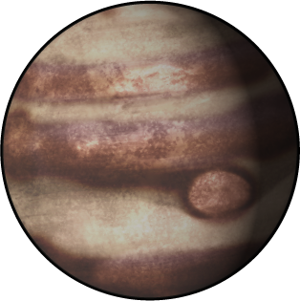
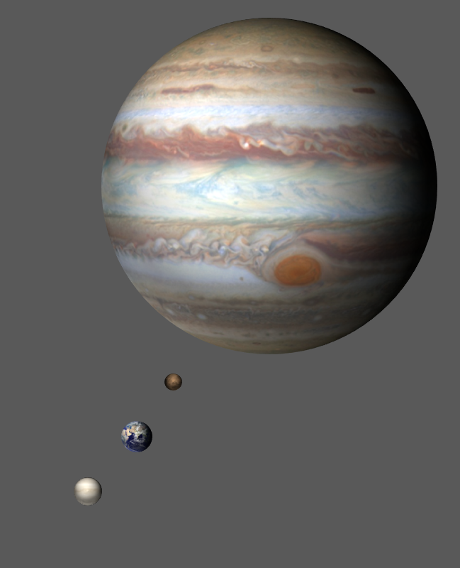
Gravity on the Moon and other planets
An object is taken to the surface of four planets.
Venus:
(0.8 of Earth’s mass)
Earth:
Mars:
(0.1 of Earth’s mass)
Jupiter:
(300× Earth’s mass)
1) Predict how you think the weight of the object will compare on the different planets.
2) Explain why you think this.

Slide 25
Gravity on the Moon and other planets
Your teacher may have bottles that are as heavy as the object feels on each planet.
Venus:
(0.8 of Earth’s mass)
Earth:
Mars:
(0.1 of Earth’s mass)
Jupiter:
(300× Earth’s mass)
3) Pick up each bottle and compare the weight of the object on each planet. Record what you found out.
4) Was your prediction and explanation correct?
See if you can write down a better explanation.

Slide 26
Gravity on the Moon and other planets
1 and 3) Compare the weight of the object on each planet.
The object felt lightest on Mars, then a bit heavier on Venus and Earth.
The object felt a similar weight on Venus and Earth, slightly heavier on Earth. The object felt much heavier on Jupiter.
2 and 4) Explain why you think this.
On planets with more mass, the gravity is stronger so the gravitational force pulling the object down is greater, making the same object feel heavier.
The object felt lightest on the planet with smallest mass, which would have the weakest gravity (Mars). The object felt heaviest on the planet with greatest mass (Jupiter), which would have the strongest gravity.

Slide 27
Gravity
Gravitational attraction
Gravity on the Moon and other planets
Gravity in our solar system

Slide 28
Gravity in our solar system
Swinging an object on a string above your head causes it to orbit in a circle.
The tension force from the string is changing the direction of the object’s movement.
tension force of the string on the object
This makes the object move round in a circle so it orbits and does not ‘fly off’. (Unless the string breaks or is released.)

Slide 29
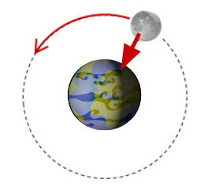
Gravity in our solar system
The Moon orbits Earth in an almost perfect circle.
gravitational force of Earth on the Moon
Earth’s gravity provides the force that causes the Moon to orbit.
The gravitational force from Earth is changing the direction of the Moon’s movement.
This makes the Moon move around Earth in a circle, so it orbits Earth and cannot escape.

Slide 30
Gravity in our solar system
Tick the four statements that are true.
a
The Moon’s orbit of Earth is caused by gravity.
b
The Moon is within Earth’s gravity.
c
The Moon has its own gravity.
d
The gravitational force from Earth pushes the Moon along its orbit.
e
Gravity pulls the Moon in the direction towards Earth.
f
Gravity pulls the Moon closer to Earth.

Slide 31
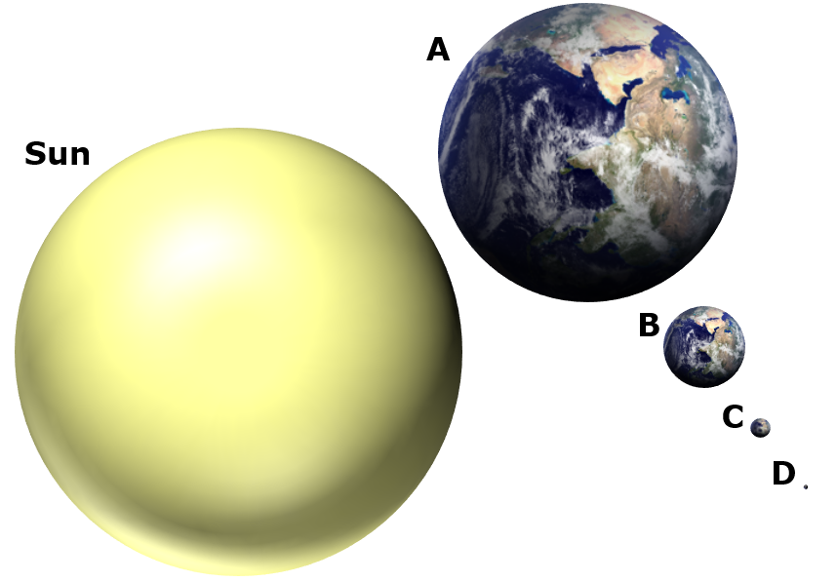
Gravity in our solar system
This shows the sizes of the Sun and Earth, to scale.
The Sun:
Earth:
(at this scale, the distance between the Sun and Earth’s orbit should be 42 screen-widths.)
The Sun’s mass is about 300,000× Earth’s mass.
So the Sun’s gravity is far stronger than Earth’s gravity, or the gravity of anything else in our solar system.

Slide 32
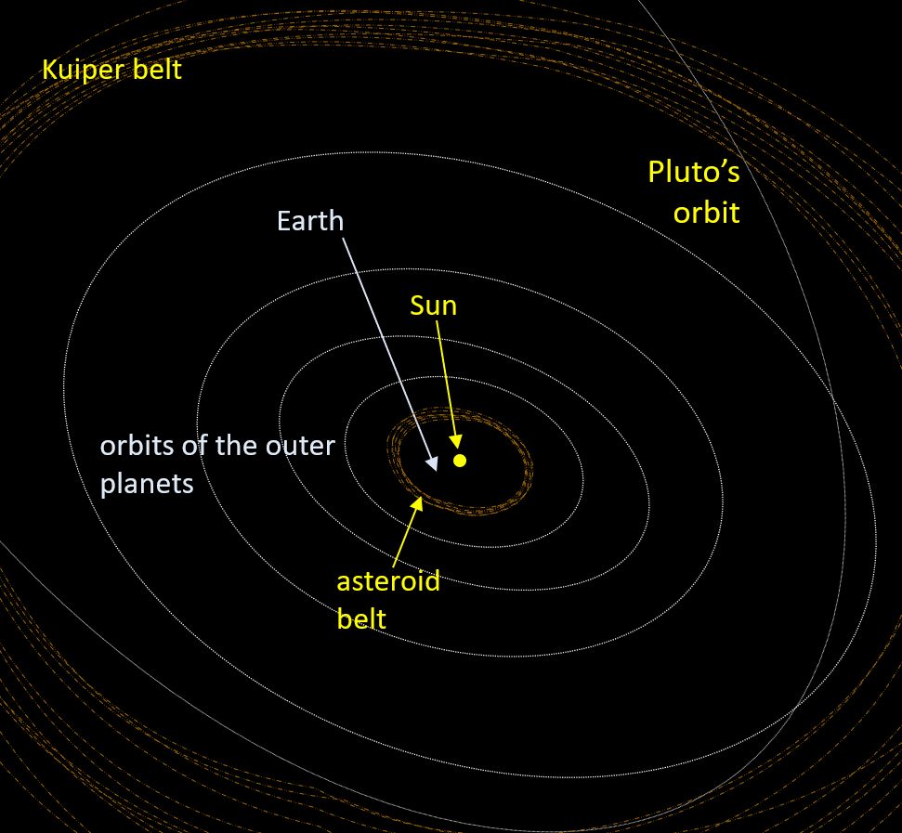
Gravity in our solar system
The Sun’s gravity extends very, very far into space.
Everything in our solar system
is within the Sun’s gravity, so experiences a gravitational force towards the Sun.
This is why everything in our solar system orbits the Sun.

Slide 33
Gravity in our solar system
For any object in our solar system, the gravitational force from the Sun is changing the direction of its movement.
This makes each object move in a circle, so it continuously orbits the Sun and cannot escape.

Slide 34
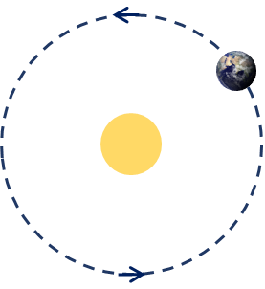
Gravity in our solar system
Fill the gaps to explain what causes Earth to orbit the Sun.
A __________ force from the Sun is changing the __________ of Earth’s movement.
gravitational
direction
This makes Earth move in a _________, so it continuously orbits the Sun and cannot escape.
circle
Which diagram correctly shows this force?
a
b
c

Slide 35
Gravity in our solar system
Discuss whether each statement is correct or incorrect, then tick the box that shows what you think.
I
am sure this is correct
I
think this is correct
I
think this is incorrect
I
am sure this is incorrect
a
There is no gravity in space.
The Sun has no gravity because the Sun has no air.
b
Saturn has stronger gravity than Earth does.
c
d
The Sun’s gravity stops the planets from escaping their orbits.

Slide 36
Gravity in our solar system
Discuss whether each statement is correct or incorrect, then tick the box that shows what you think.
I
am sure this is correct
I
think this is correct
I
think this is incorrect
I
am sure this is incorrect
a
There is no gravity in space.
The Sun has no gravity because the Sun has no air.
b
Saturn has stronger gravity than Earth does.
c
d
The Sun’s gravity stops the planets from escaping their orbits.

Slide 37
Gravity
Gravitational forces attract (pull) objects towards the centre of large objects like planets, moons and stars.
The greater the mass of an object, the stronger its gravity.
The gravity of a planet, moon or star extends far into space, but gets weaker with increasing distance.
Earth’s gravity pulls the Moon towards the centre of Earth. This changes the direction of the Moon, making it orbit around Earth.
The Sun’s gravity pulls planets towards the centre of the Sun. This changes the direction of the planets making them orbit around the Sun.

Slide 38

© Oak National Academy 2024.
Produced in partnership with University of York Science Education Group (UYSEG).
Licensed on the Open Government Licence v3.0, except where otherwise stated. See Oak terms and conditions.

