Slide 2
Y7 Theme Park Project
The following scheme of work is designed for 6 weeks. However, it seems like most of the lessons I have designed will run over the expected 1 hour time frame, so there should be plenty for your classes. If not, you may wish to include some further S&L activities, such as making the students act out their TV advert.

Slide 3
Lesson 1

Slide 4
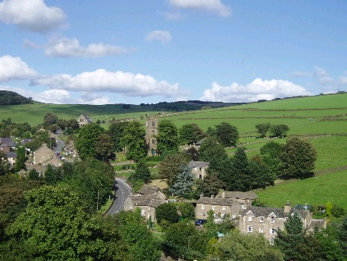
Welcome to Funn Village...

Slide 5
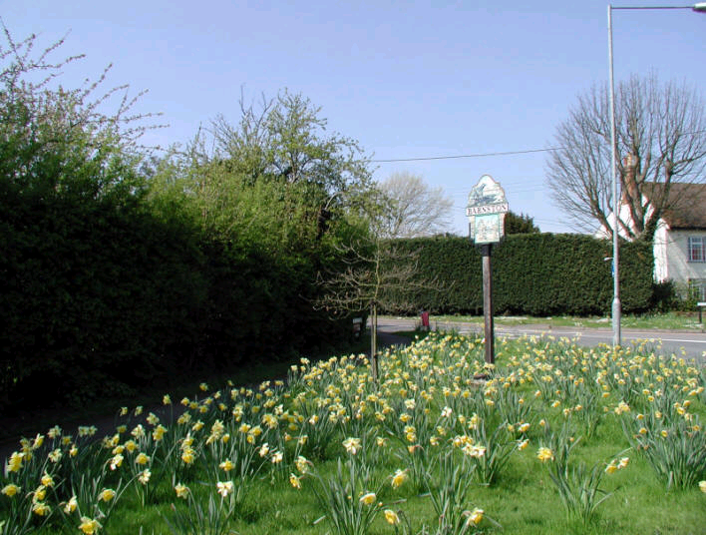

Slide 6
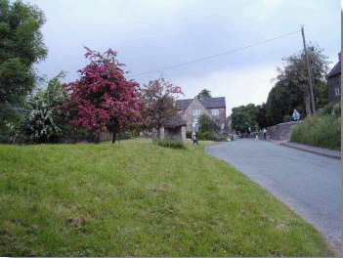

Slide 7
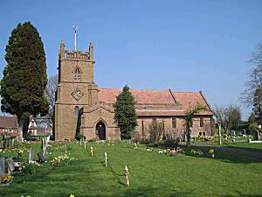

Slide 8
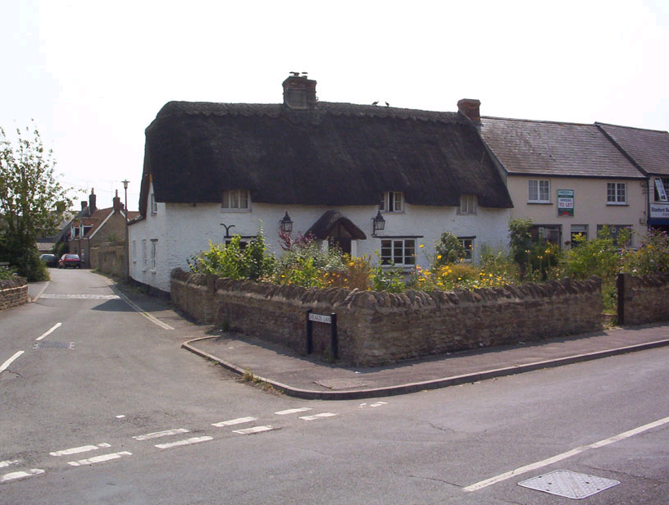

Slide 9
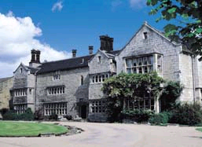
Funn Manor

Slide 10
Theme Park Proposal
Wealthy business man Mr. Buyall wants to buy Funn Manor and turn it, and its grounds, into the newest theme park. There are few places for fun in the village, so the students and kids are very exited by the idea. As well as that, there isn’t much trade for builders at the moment because the economy is so bad. However, there are several people, some very important to the village, who hate the idea. Building the park could mean a lot of noise pollution and unwanted guests for the people of the village, but it might also mean the beautiful Funn Manor isn’t preserved as it should be.

Slide 11
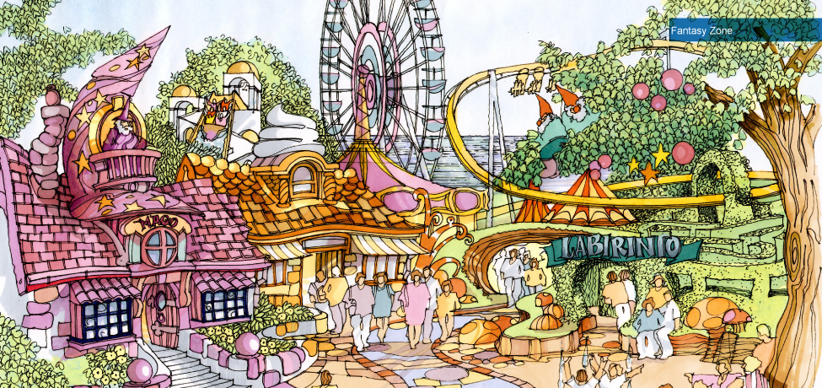
Read your sheet
Look at the following ideas about a
proposal to open a theme park in
Allerton then answer the questions

Slide 12
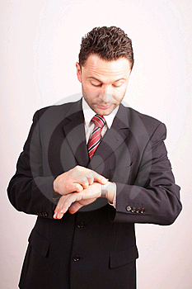
Mr. Buyall
wants to buy Funn Manor Estate to turn into a funland leisure & entertainment park. This will have all the latest, most exciting rides including ‘Space Warp’ & ‘White Water Rapids’. My Buyall would demolish the old manor house & use the estate gardens & grounds for a safari park. The construction of the fun park would create many jobs while it was being built &, when completed, it would provide even more permanent jobs for hundreds of local people. Mr Buyall argues that the manor house is in urgent need of repair & is dangerous. The gardens have been neglected & are overgrown & the lake is a danger to children in the area. He says that the fun park will benefit everyone in the community & provide a place of family entertainment.

Slide 13
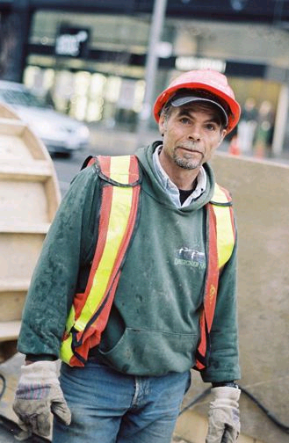
MR BUILDIT owns a local building firm. Unfortunately his firm is not doing so well at the moment as there is a lack of new projects in the area and a dip in the economy. He has heard about Mr Buyall’s proposal to buy Funn Manor to turn it into a fun park. Mr Buildit believes this is a great idea as he could expect to get a substantial amount of work for his firm. This would mean that Mr Buildit would not have to make any workers redundant as his firm can both build new buildings & renovate existing properties.

Slide 14
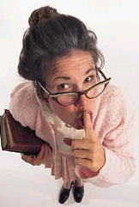
MRS FUSSY - A local secretary for the British Historical Society, wants the manor house to be preserved because it is 1 of the few outstanding examples of work designed by the famous 18th century architect, Sir Samuel Wreckit. She argues that the estate in which the manor stands is also 1 of the best examples of landscape gardening ever done by the famous “Capability Brown”. She says visitors from all over the world come to view the manor house which is listed as a building of historical importance & that to destroy a part of British heritage & to replace it with a fun park would be a national disgrace! She also points out that the construction of a fun park would mean building a new road through the village of Funn as the narrow winding roads would be unable to cope with the increased volume in traffic. This would mean that some people would have their houses demolished & others would have heavy traffic flowing past their doorsteps all day long. The extra traffic in the village is also a danger for the children.

Slide 15
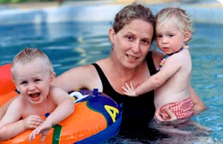
MISS KILLJOY is a local resident. She and her two young children live near to Funn Manor. She is greatly concerned about the proposed idea to build a fun park near her house. Her major
concern is noise pollution as the loud music, mechanical noises from the rides and screaming visitors will be heard from inside her home. This noise might keep her children awake during evenings in the summer when the fun park would be open late. Peaceful days in the garden will also come to an end. Like Mrs Fussy, Miss Killjoy is also concerned about the increase in traffic and dangerous roads.

Slide 16
Debate
In order to decide whether allowing Mr Buyall to purchase the manor is a good idea, the people of the village are going to have a debate inside the town hall.
You will each take a role, consider the opinion and idea you are given and everyone will take part.

Slide 17
Mr Buyall He wants to buy Funn Manor in order to turn it into a theme park. He thinks it will benefit everyone as it will bring tourism to the area as well as somewhere fun for kids. | Mr Buildit He is happy about the possibility of the theme park coming to the area. His firm hasn’t had much work in the past year and the money is thin. He thinks it will benefit job in the area. | Mrs Fussy She doesn’t want Funn manor turned into a theme park. She thinks it should be preserved and used like a museum so the people of the village can understand its greatness.
Miss Killjoy She doesn’t want a theme park in her village. She is worried about the negative impact it could have on her and her children’s lives. She wants her children to live in a nice, quiet area. | Mr Mayor The mayor of the town is undecided. He thinks it could be a good idea to bring more money into the small village, but it could cause a lot of unnecessary problems with the residents. | Mrs Mayor She is trying to convince her husband that the park is a bad idea. She doesn’t want to live in a place that is known only for a theme park. She is raising her young son in this village.
Mrs Elder She has lived in Funn Village all of her life. She used to work in Funn Manor as a maid and knows more about the building than most people in the village. | Mr Ancestor He has a lot of sentimental feelings towards the village and the manor. His mother and father were married in Funn Manor over 70 years ago. | Miss Learner She is the teacher at the only school in the village. She worries that a theme park would stop students studying and would cause a drop in their exam results.

Slide 18
Mr Nahthen He is the chief of police in the village and worries about the level of crime that the tourists could bring with them. His police station currently only holds 10 policemen as it’s a small, quiet village. | Bobby Smith He is a student studying in Sheffield, but living in Funn Village. He chose to live there to get away from the hustle and bustle of city life. Having a theme park will make Funn Village what he doesn’t want. | Mrs Skiint She has been out of work for the last 3 months because the factory a few miles away had to make redundancies. She thinks the theme park will allow her to work again and claw at her debt.
Miss Joyfill She lives in Funn Village with her family. She’s never liked it there because there’s nothing to do. This would bring more to the village and make it more exciting. | Mr Wettre He is a plumber who has enjoyed steady work throughout his career. He is undecided about it. It may show him some benefits, but it won’t affect him much. | Mrs Ooarr She is the local farmer’s wife. She thinks there might be a benefit for her farm animals as a mini-farm in the theme park. She can see a benefit for her and her husband.
Anna Jones Anna is only 10 but is bored of her village. She wants something to do instead of staying at home, playing video games and watching TV. She’s very excited about the theme park. | Mr Ooarr He thinks he can sell more of his goods if there are more people around, but he knows the benefit won’t begin to show for quite some time, so he isn’t desperate to push the idea. | Miss Goldsmith She owns her own company which is struggling a little. She hopes to sponsor the new theme park for a while and drum up some new publicity for her company.

Slide 19
Rev. Kev Knox He works at the church in Funn Village. He thinks that something like a theme park could break the peace of the tranquil village and ruin the area. | Dean Johnson He is in a band in a nearby town and thinks if he can play at the opening of a new theme park, or get a residency, his band could break into the industry. | Mrs Angel She is a designer who wants a big project to work on. Although she doesn’t do architecture she wants to work on the theme park designing things like the logo.
Miss Bluprint She is excited about the theme park as she might get her big break designing the rides, which she has been working towards at the local engineering University. | Mr Councillor He works in the area on behalf of the government. He is impartial and wants to hear everyone’s opinions. He has a lot of questions for Mr Buyall about his project. | Mrs Buyall She wants her husband to buy Funn Manor so her family can settle down in the nice area of Funn Village. She is sick of moving around for his work so often.
 | Mr Greenthumb He has been the gardener at Funn Manor for the past 15 years. He is sad to think they might be destroyed so someone can tarmac over it and make it a metal playground. | Miss

Slide 20
Debate
Consider your character and their feelings. I will play the chairperson and will ask different people questions. You can also respond to each other.
I will have to come to a decision about the theme park by the next lesson.

Slide 21
Self Assessment
Assess how you did in the debate by copying out and ticking off the following list:
Didn’t talk over anyone
Took it in turns
Put my hand up when I wanted to talk
Considered my character
Asked questions
Responded appropriately and formally.

Slide 22
Lesson 2

Slide 23
Should the Theme Park Be Built?
Last lesson you each had a character to portray.
Today, you need to get back in to that character and write a letter to the chairperson of the debate reiterating your ideas and opinions.

Slide 24
Formal Letter Writing
In groups, using your white board, draw a mock-up of how you think a formal letter should look.

Slide 25
Formal Letter Layout
Their Address
Your Address
  8 Smithy Lane
  Dronfield
  Derbyshire
  S18 2FT
18th May 2011
Baroness Mayfield
The Manor House
Manor Park
Manor Village
Derbyshire
Dear Baroness Mayfield,
End your letter:
Yours sincerely (if a name)
Yours faithfully (if Sir/Madam or don’t know name)
Today’s date
Formal opener

Slide 26
Formal Letter Writing Sentence Starters
In my opinion...
When I was at the debate someone said...
I don’t agree with...
Funn Manor is...
Funn Vilage is...
Would you...?
Have you thought about...?

Slide 27
Peer Assessment
Did your partner:
Lay out the letter like we discussed?
Write in full sentences?
Sign off the letter appropriately?
Use capital letters and full stops?
Explain their ideas fully?
Write them a PIN bearing all of those questions in mind.

Slide 28
Reply from the Chairperson
Dear Sir / Madam
Thank you very much for your letter. After much deliberating we have decided to grant Mr Buyall’s request to purchase Funn Manor with the aim of turning it into a theme park. We hope this will benefit the village and make it an even better place to live.
Thank you for your time.
Yours Faithfully
Madame Chairperson

Slide 29
Exit Ticket
Take your post it note.
On it, write down the name of your character and 3 words to describe how your character feels about this revelation about the new theme park that will be coming to Funn Village.
Stick it on the whiteboard.

