Slide 1
Globalisation challenges
Task A: How can globalisation affect the environment?
1. Globalisation can lead to global and local environment impacts. Give two examples for each.
Local impacts
Global impacts
2. Explain which you think is worse and why.

Slide 2

Globalisation challenges
Task B: How can globalisation affect business?
State your opinion of a new supermarket in your local town from two different perspectives. Explain why you feel that way.
A shop owner in your local town
A young adult looking for work
Task C: How can globalisation affect culture?
1. State how globalisation has led to a loss of cultural identity in these three areas:
food
v2.5

Slide 3
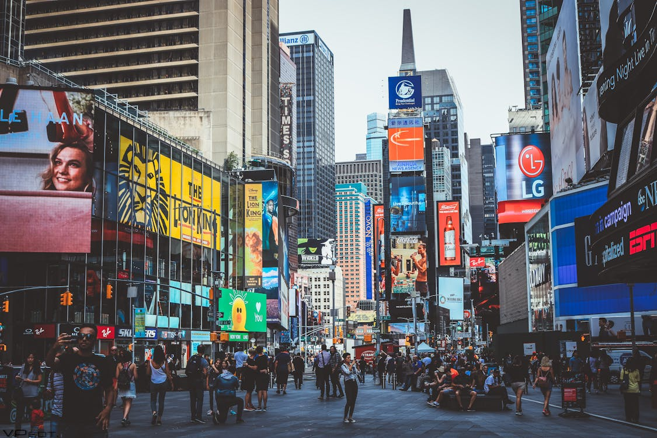
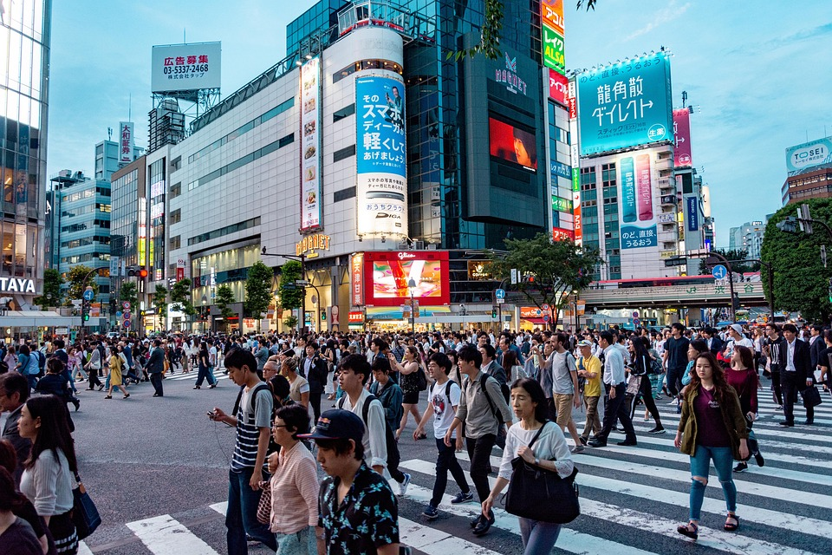
Globalisation challenges
language
clothing
2. Using these photographs, explain how globalisation can lead to cities looking similar.
New York, United States
Tokyo, Japan

