Slide 1
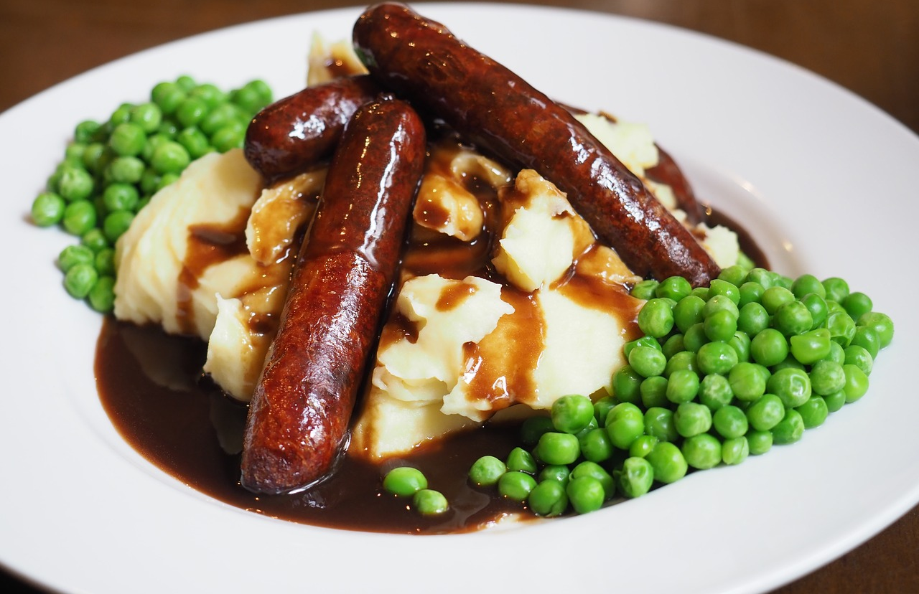

The distance food travels
Task A: How far does our food travel?
Use an atlas to calculate how far ingredients for this meal might have travelled if:
obtained from suppliers in the UK
imported from other countries
For each option, calculate the total distance the foods in this meal have travelled and compare the two totals.
Food sourced from the UK
Distance (kil
Food sourced from the UK | Distance (kilometres)
peas from Boston, Lincolnshire
sausages from Swansea, Glamorgan
potatoes from Girvan, Ayrshire
carrots from Cambridge, Cambridgeshire
ice cream from Bodmin, Cornwall
Total distance

Slide 2

The distance food travels
Food sourced from other countries | Distance (kilometres)
peas from Cape Town, South Africa
sausages from Auckland, New Zealand
potatoes from Cairo, Egypt
carrots from Groningen, Netherlands
ice cream from Rome, Italy
Total distance
2. Write one or two sentences to explain why we might import food from other countries even when it can be grown or produced in the UK.

Slide 3
Task B: What are the consequences of food miles?
The distance food travels
Debate the motion: Sourcing our food locally is better than importing it from other countries. You can make notes below.
Find a partner and number yourself 1 or 2.
Number 1s should speak for two minutes to support the motion. Number 2s should then speak for two minutes against the motion.
Now, swap over and repeat the activity with Number 1s speaking against the motion and Number 2s speaking for the motion.
v2.3

