Slide 1
The UK’s peaks
Task A: What are the UK’s highest peaks?
Complete the sentences below by filling in the gaps.
The highest mountain in ______ is called Ben Nevis and it is also the ______ mountain in the UK. Mountains in Scotland are also referred to as ______.
The highest mountain in Wales is called ______, which translates to ______ in English. Yr Wyddfa is ______ metres above sea level.
The highest mountain in England is called ______, it is located in the ______ National Park.
The highest mountain in Northern Ireland is called Slieve Donard and it is located in the ______ National Park.
Scafell Pike 1085 Scotland Yr Wyddffa highest Grampian Munros Mt Snowdon Lake District

Slide 2
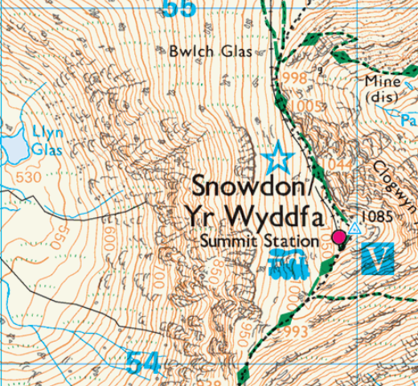
Task B: How do maps represent mountains?
The UK’s peaks
© Crown copyright & database right Ordnance Survey licence no. 100067257, 2023
What do contour lines show us?
What is the height of the land here?
What other features can you see on this map?
Is each one a human feature or a physical feature?
v2.3

