Slide 1
The impact of eruptions: Eyjafjallajökull, Iceland
Task A: Why is the Mid-Atlantic Ridge important?
Fill in the missing words.
Iceland is located on the ______. Here two tectonic plates move apart or ______. These are the North American plate which moves ______ and the Eurasian plate which moves ______ to form volcanoes. The Mid-Atlantic ridge is ______ long and moves apart approximately ______ each year. The eruption here occurred on 14th April _____and lasted over a ______.
2.5 cm 2010 Mid-Atlantic ridge east month west 16,000 km diverge

Slide 2
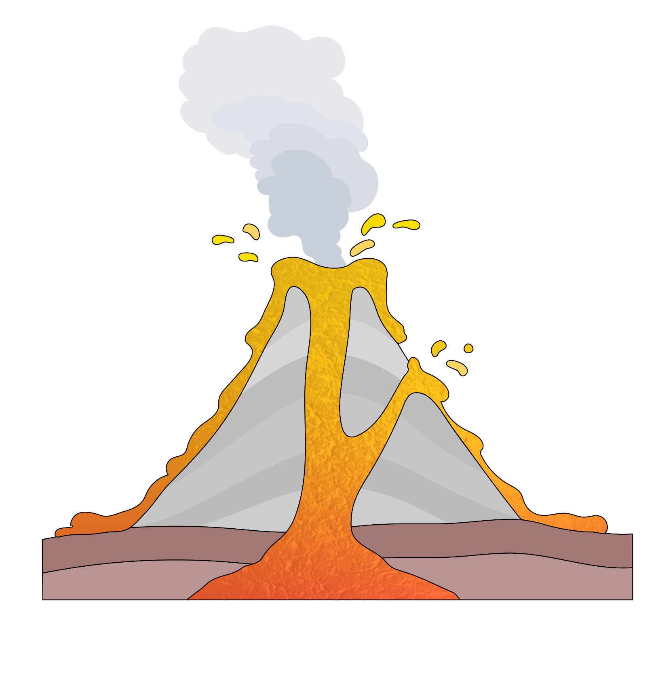
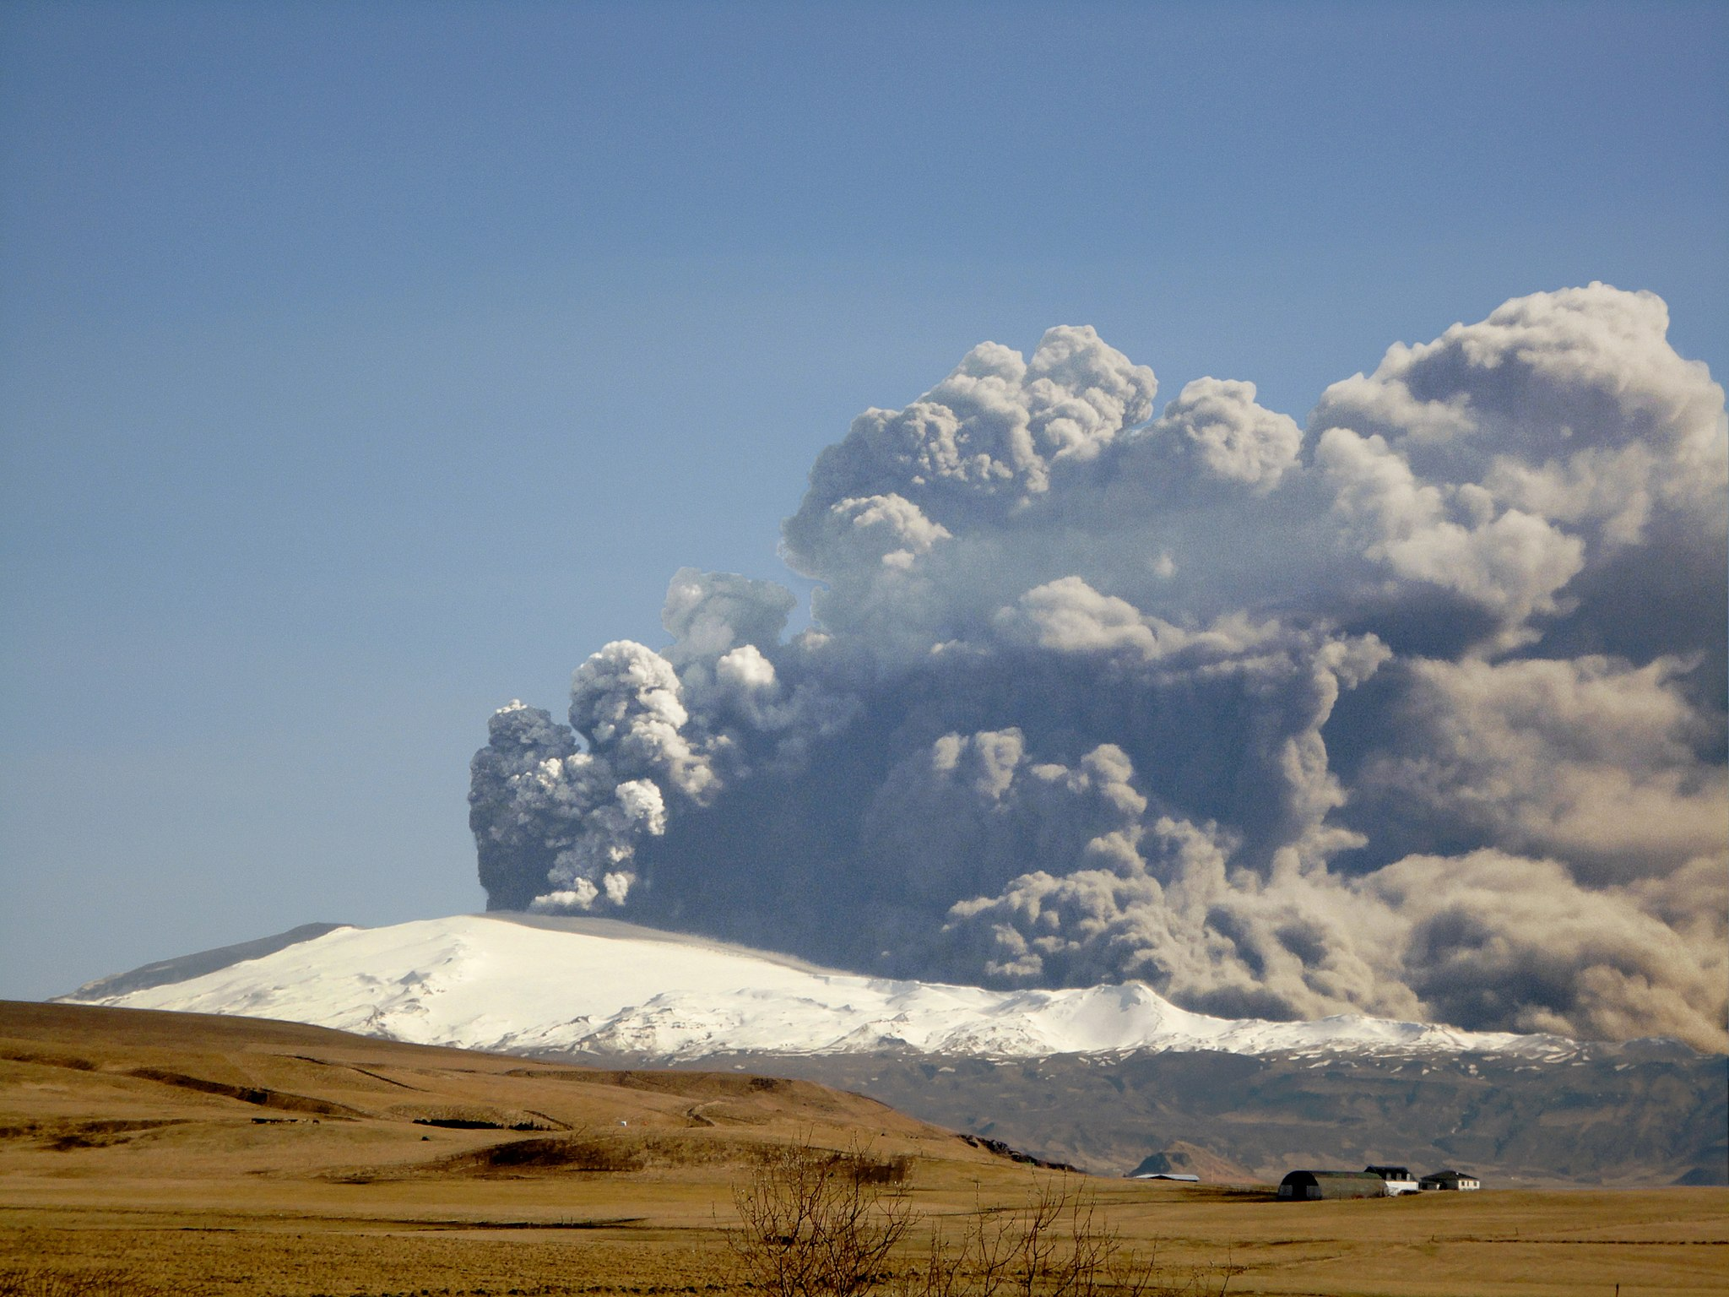
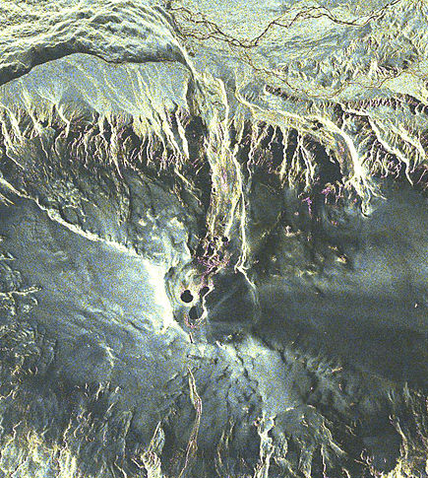

Task B: What was the impact of the eruption of E15?
The impact of eruptions: Eyjafjallajökull, Iceland
Make a flowchart to explain the impact of the eruption of E15. Use these images to help you.
v2.3

